Slide 1
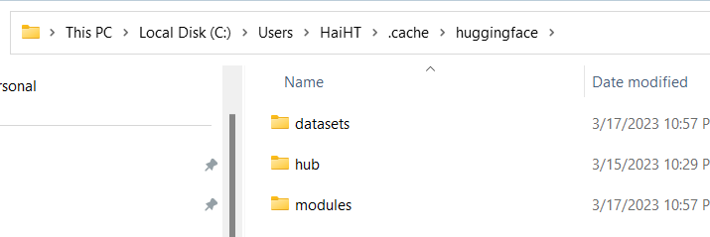
Quick Note
https://huggingface.co/docs/transformers/index
https://huggingface.co/docs/transformers/v4.26.1/en/model_doc/distilbert#transformers.TFDistilBertForTokenClassification
C:\Users\HaiHT\.cache\huggingface
For model download
For datasets download

Slide 2
Self-Supervised Learning
Automatically computed from the inputs of model. Human are not needed to label the data
GPT, BERT, BART, T5…

Slide 3
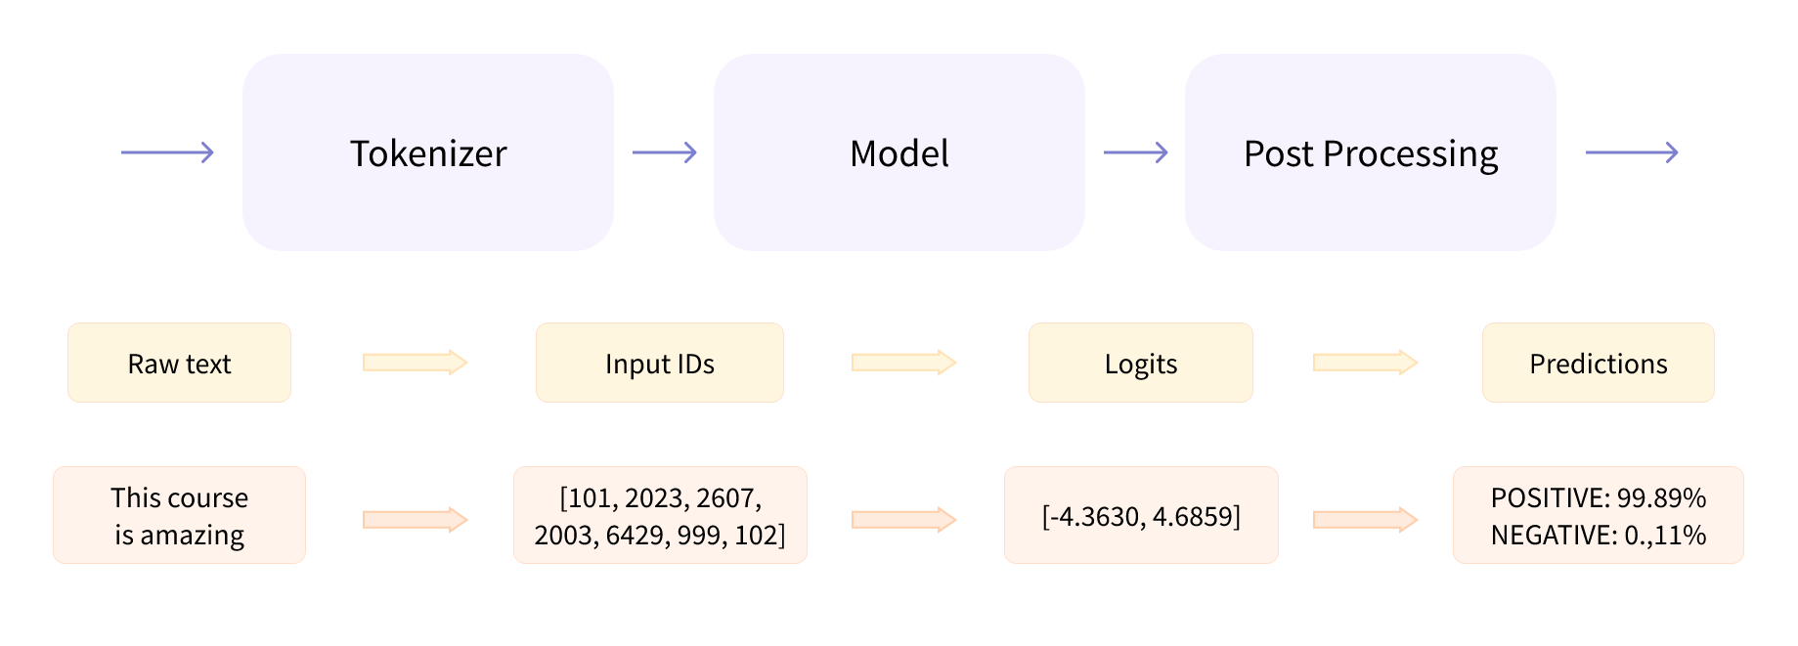
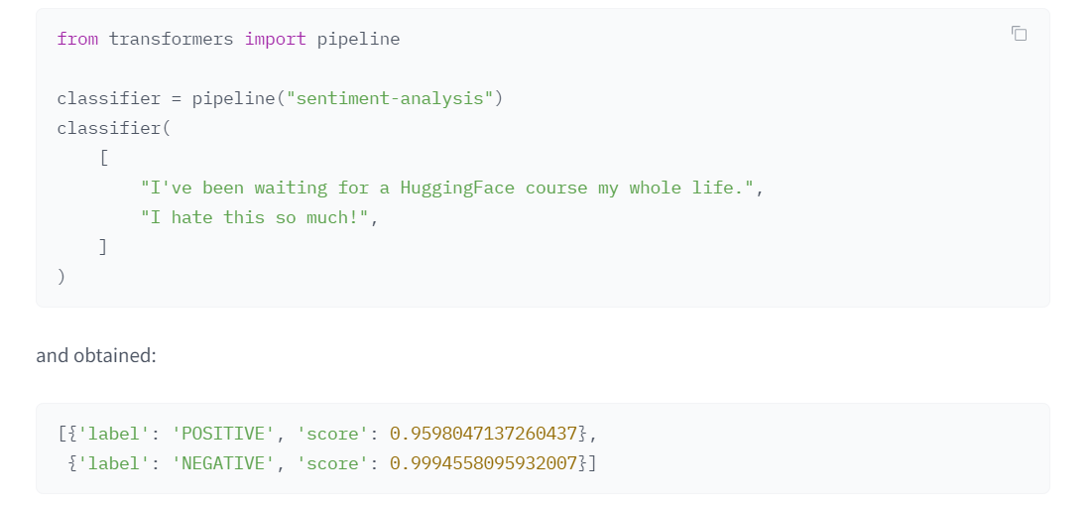
Behind the pipeline

Slide 4
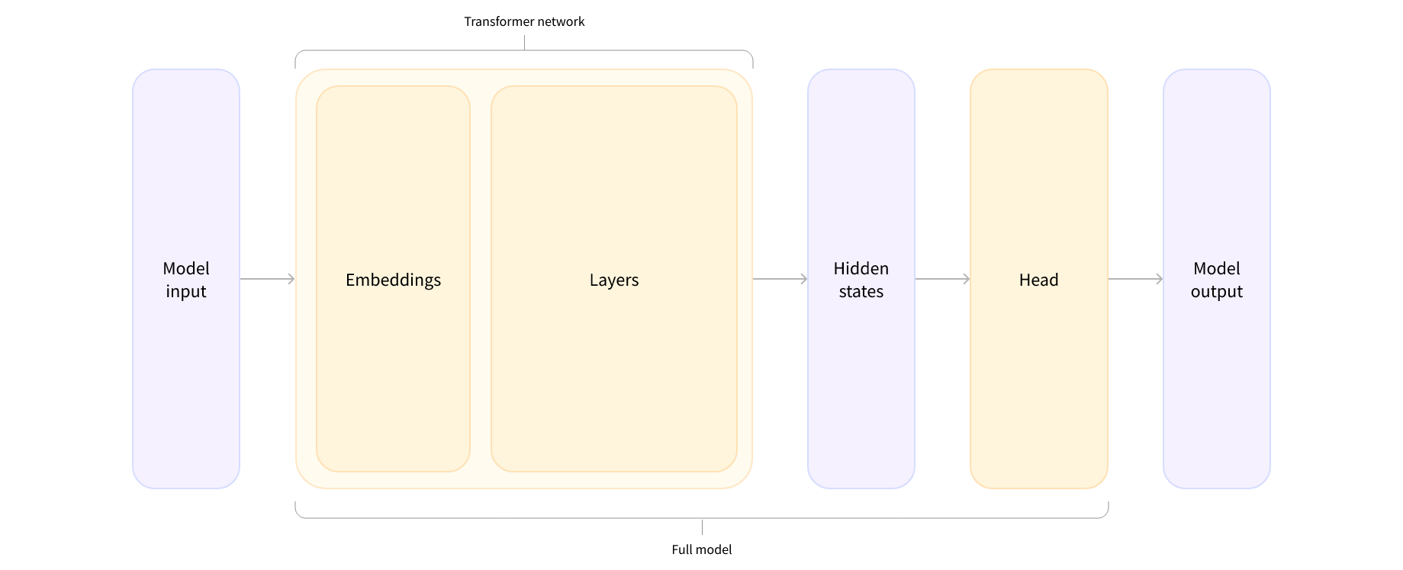
Behind the pipeline Model heads
*Model
*ForCausalLM
*ForMaskedLM
*ForMultipleChoice
*ForQuestionAnswering
*ForSequenceClassification
*ForTokenClassification

Slide 5
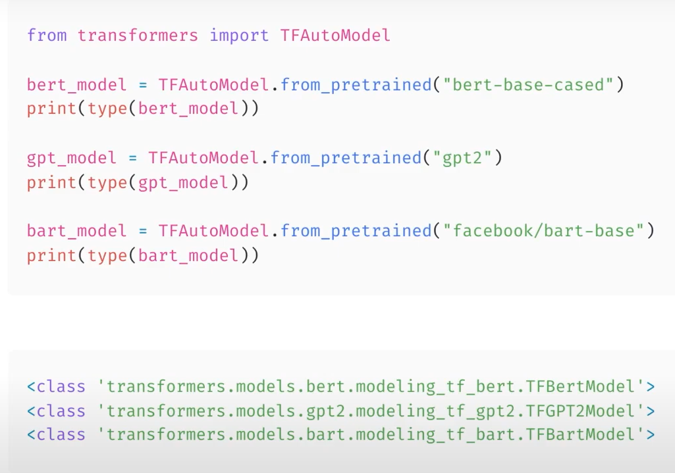
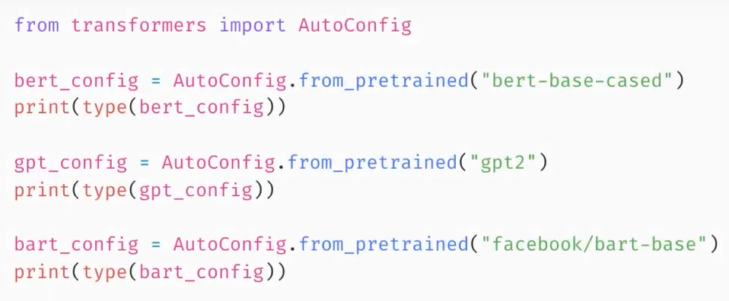











Models
Load models
Load config

Slide 6
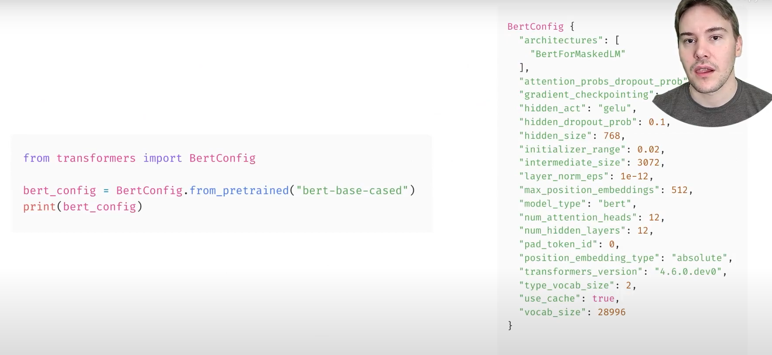
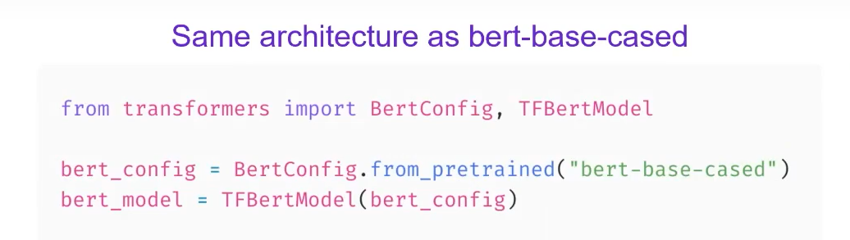
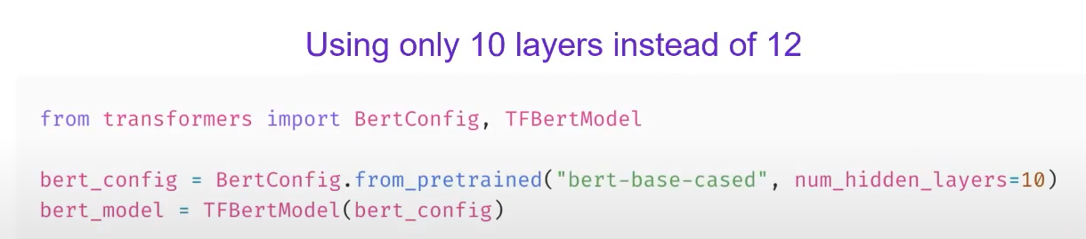
Model config

Slide 7
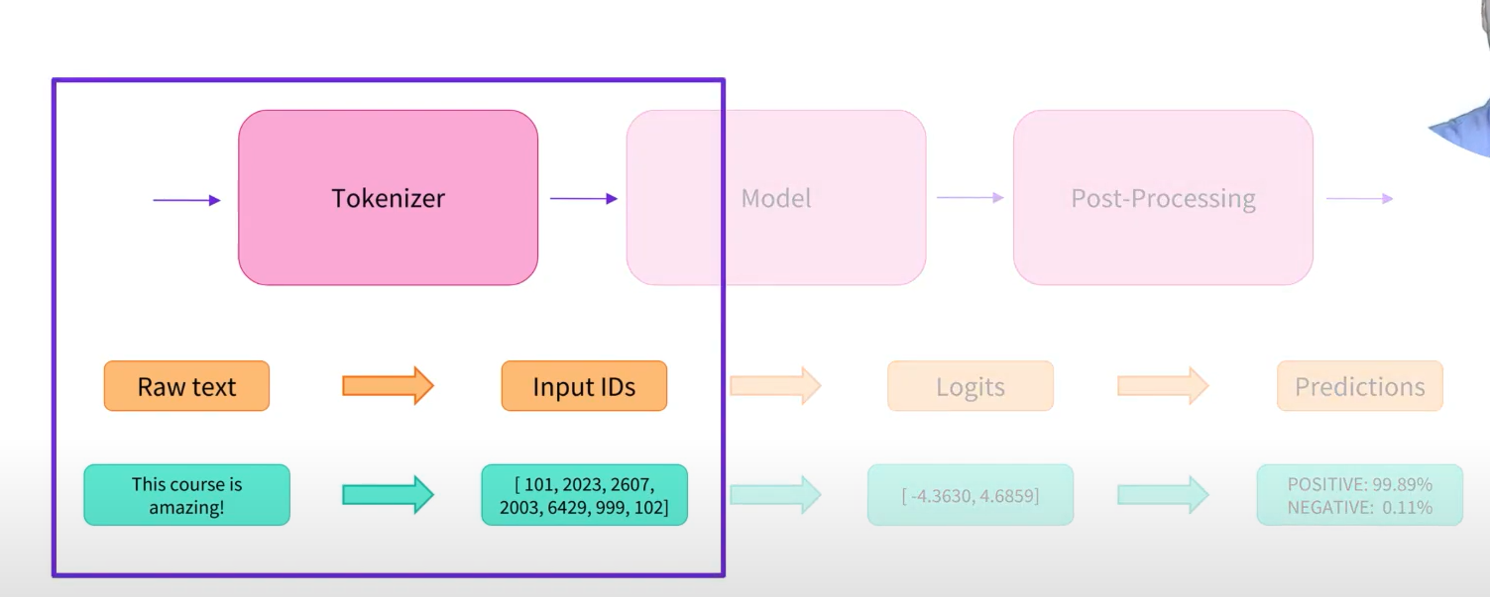
Tokenizer

Slide 8
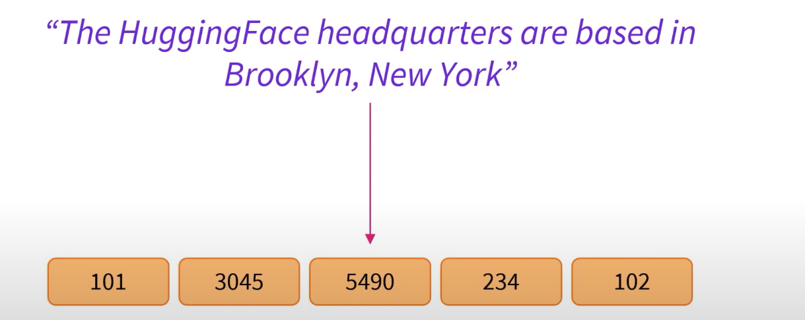






Tokenizer
Tokenizer objective: to find the most meaningful representation

Slide 9
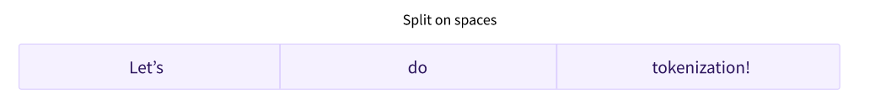
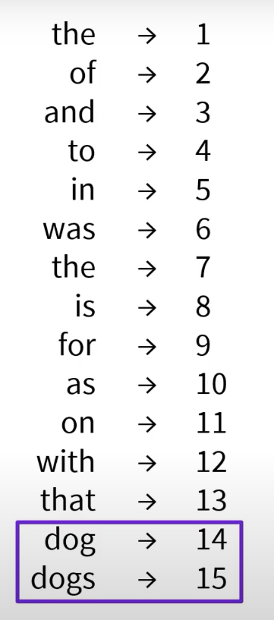
Tokenizer >> Word-based Representation
Split words by some rules: spaces, punctuation

Slide 10
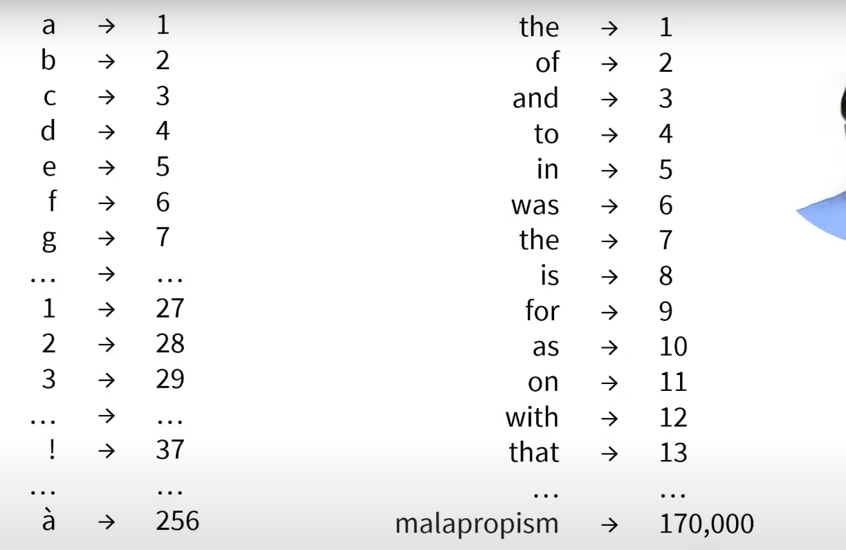
Tokenizer >> Character-based representation

Slide 11
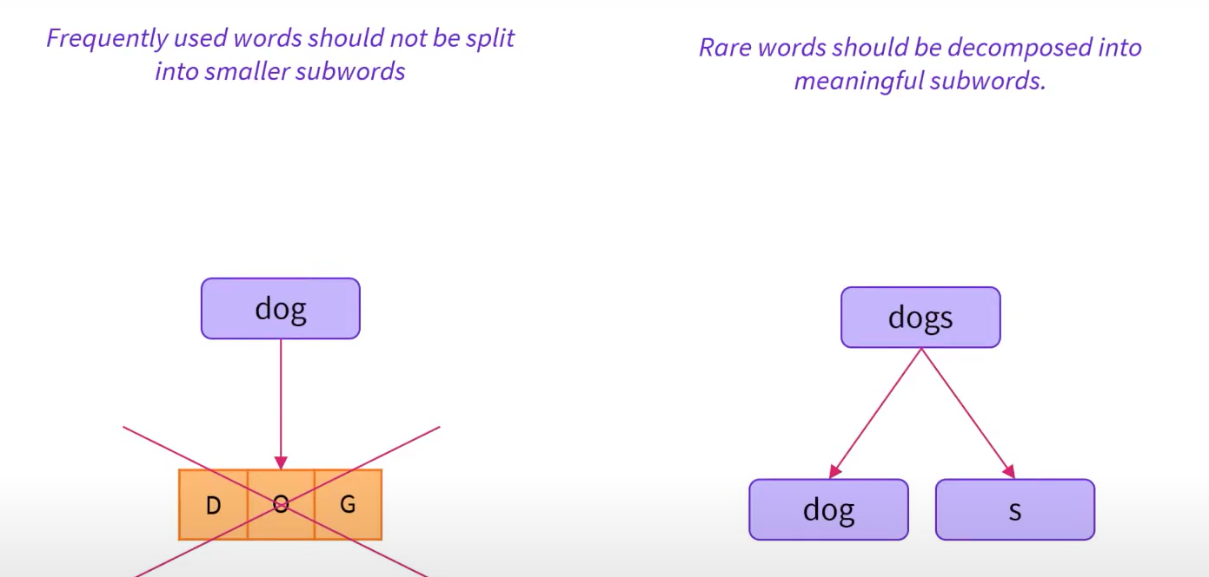
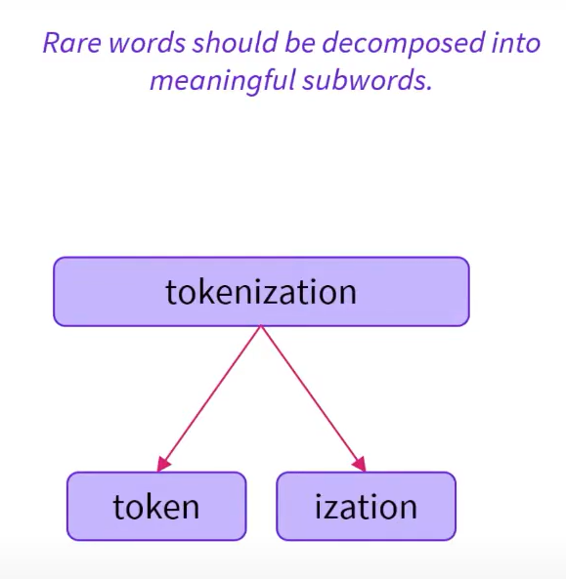
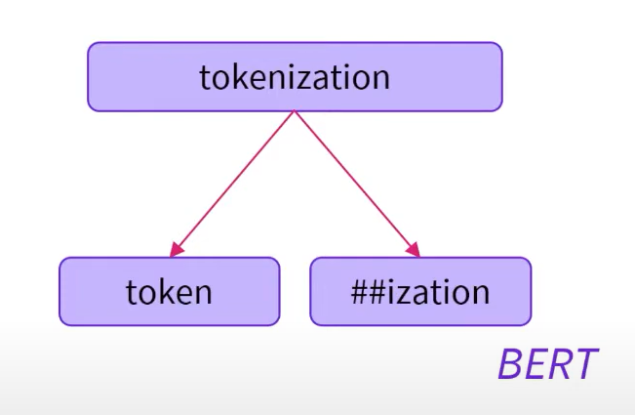
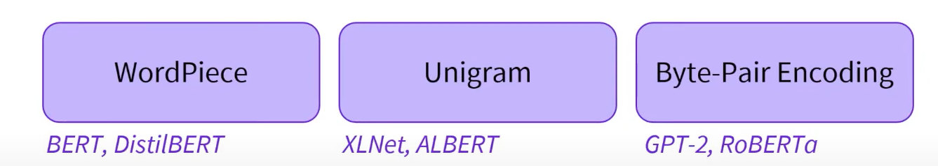
Tokenizer >> Subword-based representation
Based on 2 principles:
Frequently used words should not be split into smaller subwords
Race words should be decomposed into meaningful subwords

Slide 12
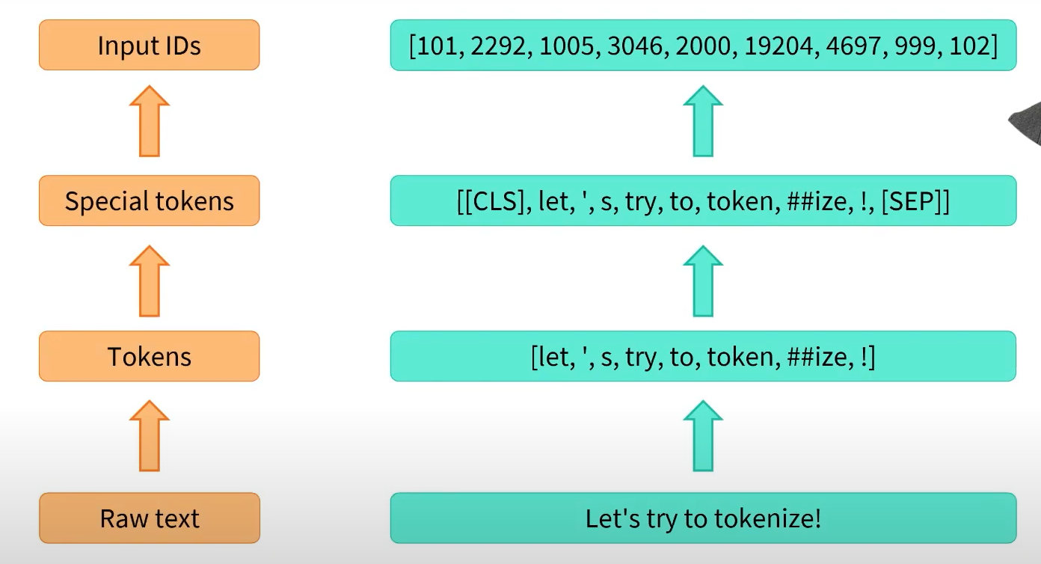


Tokenizer Pipeline

Slide 13
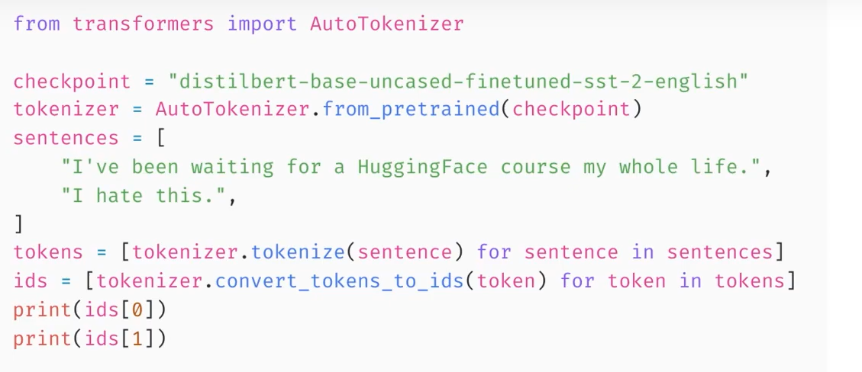
Batching Inputs together

Slide 14
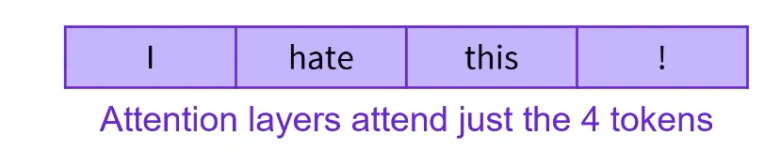

Padding in batch

Slide 15








Dataset on HuggingFace >> Glue

Slide 16
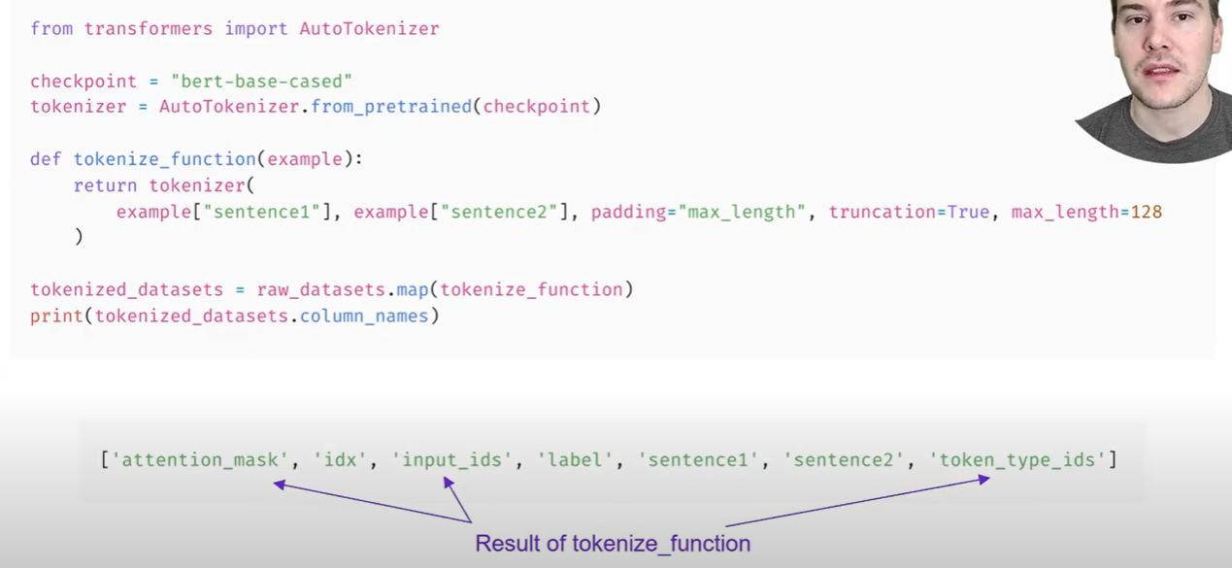

Load Dataset from HuggingFace Hub

Slide 17
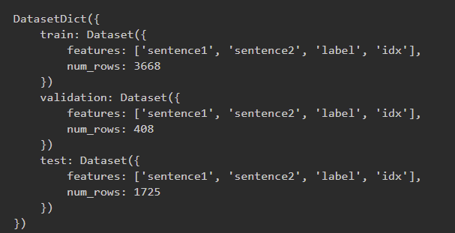
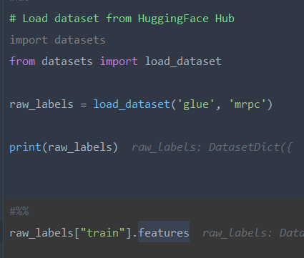
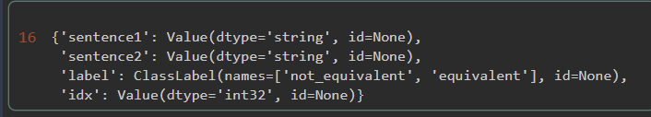


Discovery feature/information of Hugging Dataset

Slide 18
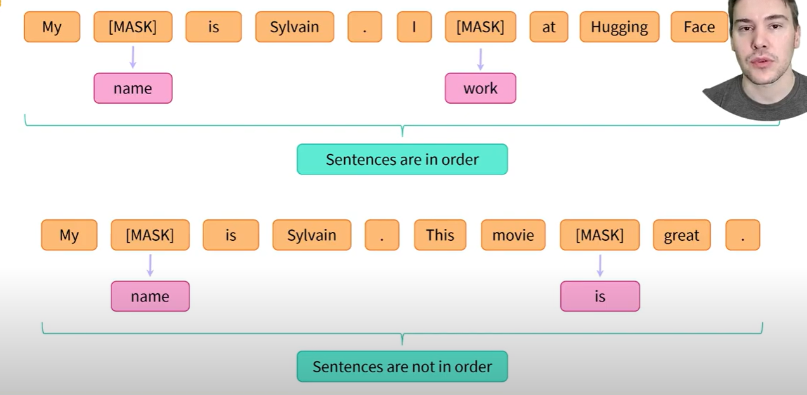
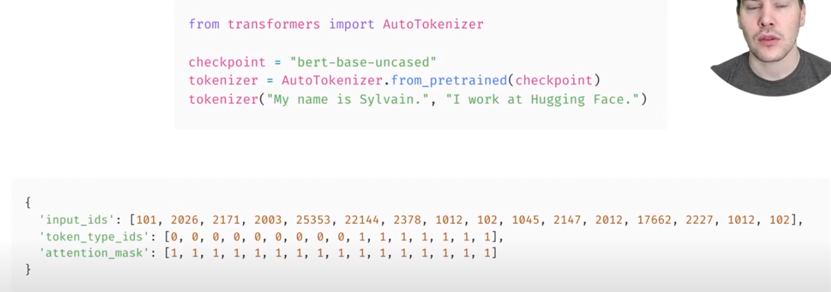
Preprocesing Sentence Pair

Slide 19
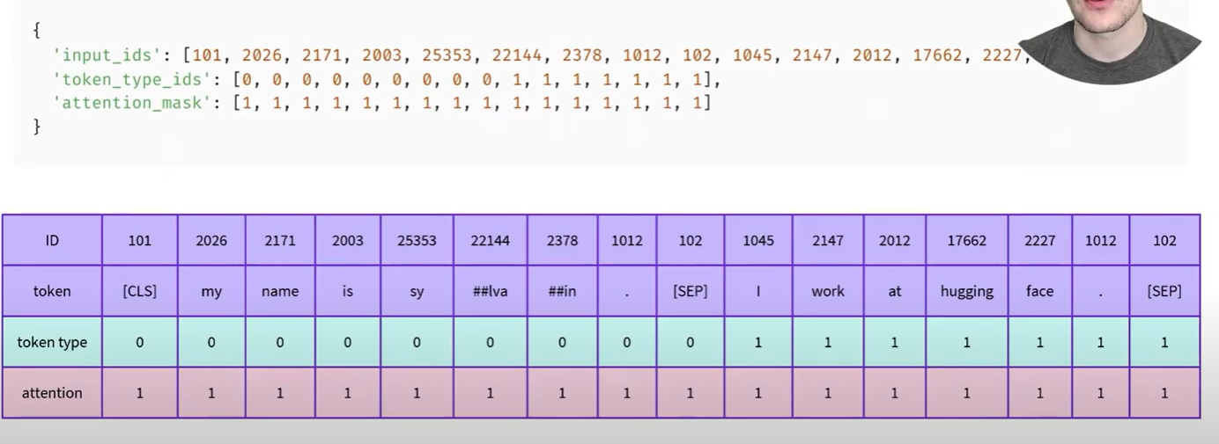
Preprocesing Sentence Pair

Slide 20
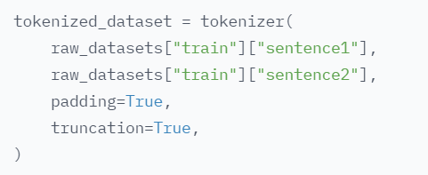

Processing Sentence Pair

Slide 21
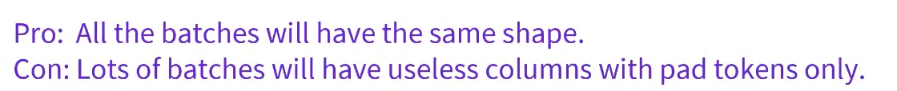
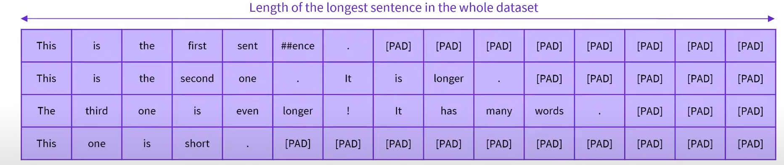
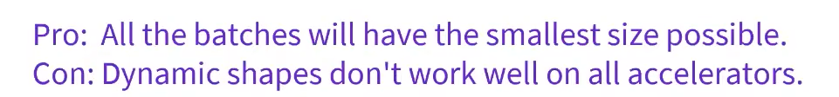
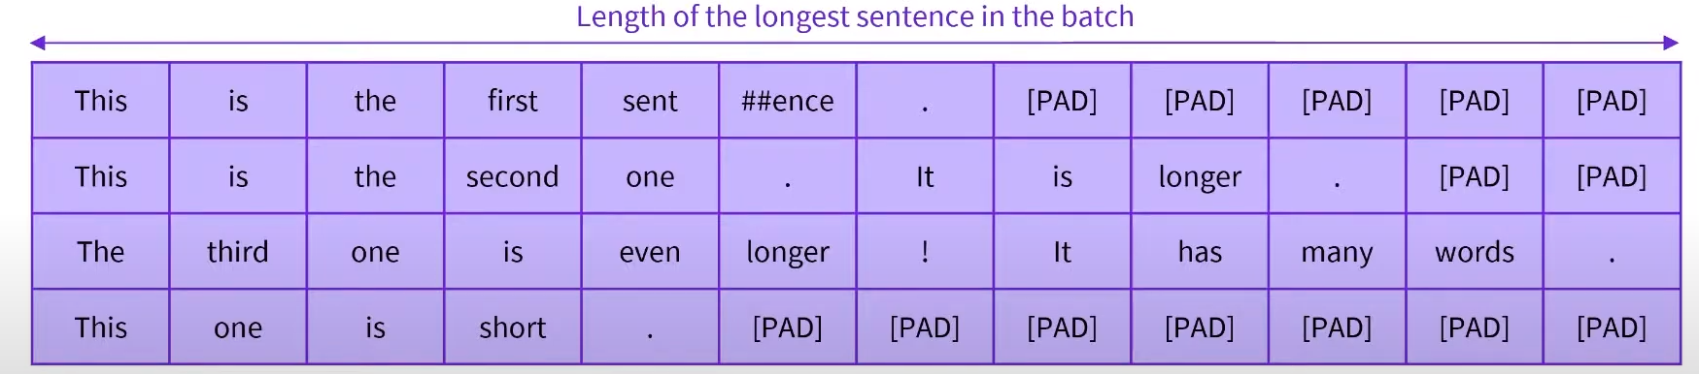
Dynamic Padding

Slide 22
TODO list
https://huggingface.co/course/chapter3/2?fw=tf

Slide 23
FastTokenizer
Parallel processing capabilities backed by Rust
Faster 20 times than slow one
print(tokenizer.tokenize("Let's talk abount tokenizer superpowers"))
['Let', "'", 's', 'talk', 'a', '##bo', '##unt', 'token', '##izer', 'super', '##power', '##s']
tokenizer_roberta = AutoTokenizer.from_pretrained("roberta-base") print(tokenizer_roberta.tokenize("Let's talk abount tokenizer superpowers"))
['Let', "'s", 'Ġtalk', 'Ġab', 'ount', 'Ġtoken', 'izer', 'Ġsuper', 'powers']

Slide 24
FastTokenizer
Can keep track of the word each token comes from
encoding = tokenizer("Let's talk abount tokenizer superpowers") print(encoding.tokens()) print(encoding.word_ids())
['[CLS]', 'Let', "'", 's', 'talk', 'a', '##bo', '##unt', 'token', '##izer', 'super', '##power', '##s', '[SEP]']
[None, 0, 1, 2, 3, 4, 4, 4, 5, 5, 6, 6, 6, None]

Slide 25
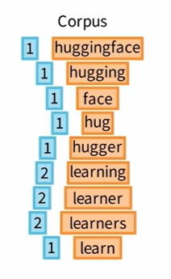
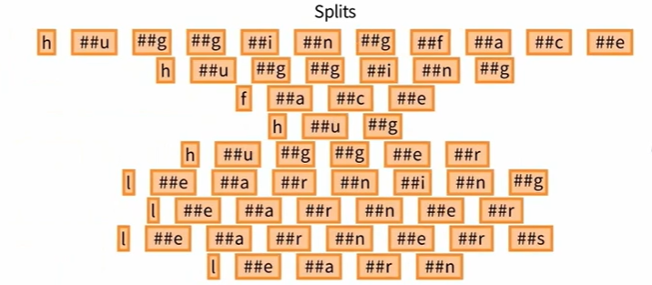
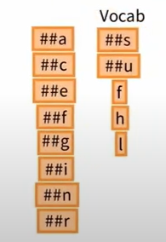
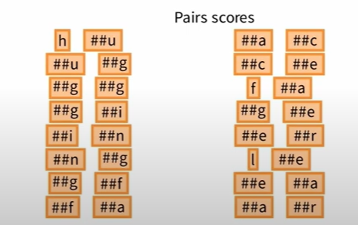





WordPiece Tokenization
Similar to BPE algorithm, but differ the way the score for each candidate token is calculated

Slide 26
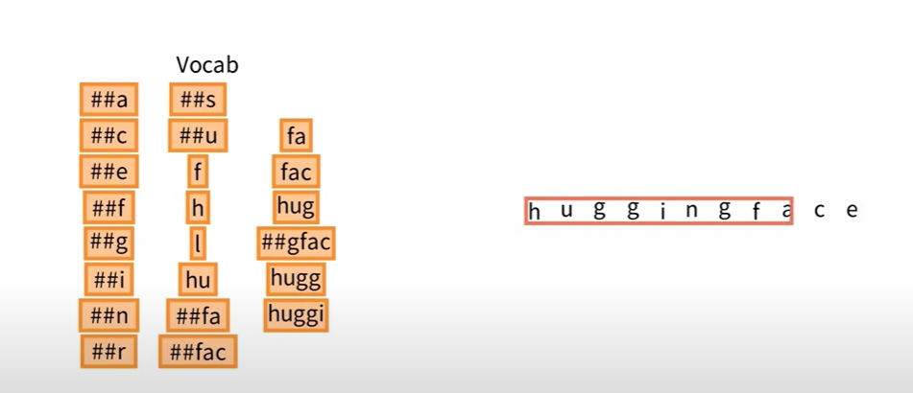
WordPiece Tokenization

Slide 27
Debug
From model_checkpoint >> load from HF or local >> find the config >> find the model_type (example ‘bert’) >> Load model module (ex: BertModel), load pair of tokenizer (slow or fast, ex BertTokenizer, BertTokenizerFast) >> Create tokenizer objects (BertTokenizer /BertTokenizerFast) >> Load pretrained (vocab) from HF or local
For “bert-base-cased” model
class 'transformers.models.bert.tokenization_bert.BertTokenizer’
class 'transformers.models.bert.tokenization_bert_fast.BertTokenizerFast’
We can init BertTokenizer manually create an instance BertTokenizer with vocabfile (C:\Users\HaiHT\.cache\huggingface\hub\models--bert-base-cased\snapshots\5532cc56f74641d4bb33641f5c76a55d11f846e0\vocab.txt)
tokenizer = BertTokenizer(vocab_file='C:\\Users\\HaiHT\\.cache\\huggingface\\hub\\models--bert-base-cased\\snapshots\\5532cc56f74641d4bb33641f5c76a55d11f846e0\\vocab.txt')

Slide 28
TFBertTokenizer vs BertTokenizer (standard HF)
This is an in-graph tokenizer for BERT. It should be initialized similarly to other tokenizers, using the `from_pretrained()` method. It can also be initialized with the `from_tokenizer()` method, which imports settings from an existing standard tokenizer object.
from transformers.models.bert.tokenization_bert_tf import TFBertTokenizer

Slide 29
Transformer >> tokenization_utils.py
Trie
add: add token
split: split text into tokens
PreTrainedTokenizer:
Base class for all slow tokenizers
Use a Trie to build tokens
Can update current vocab by add_tokens. This function will add new added token in current vocabulary by indexing ID of token by one. Then rebuild whole a trie for searching token

Slide 30
Trie in Hugging Face
data:
Build nested dicts
trie.add("Hello 友達")
trie.data {"H": {"e": {"l": {"l": {"o": {" ": {"友": {"達": {"": 1}}}}}}}}}
split:
Split text into tokens and remained text

Slide 31
Trie >> split
Tokens: Hai, HaiHT
H
a
i
H
T
D | o |  | H | a | i | H | T |  | s | o | m | e | t | h | i | n | g
0
1
2
3
4
D
o
H
a
X
X
X
Y
X
States:
3:
a
i End
H
T End
3:
i End
H
T End

Slide 32
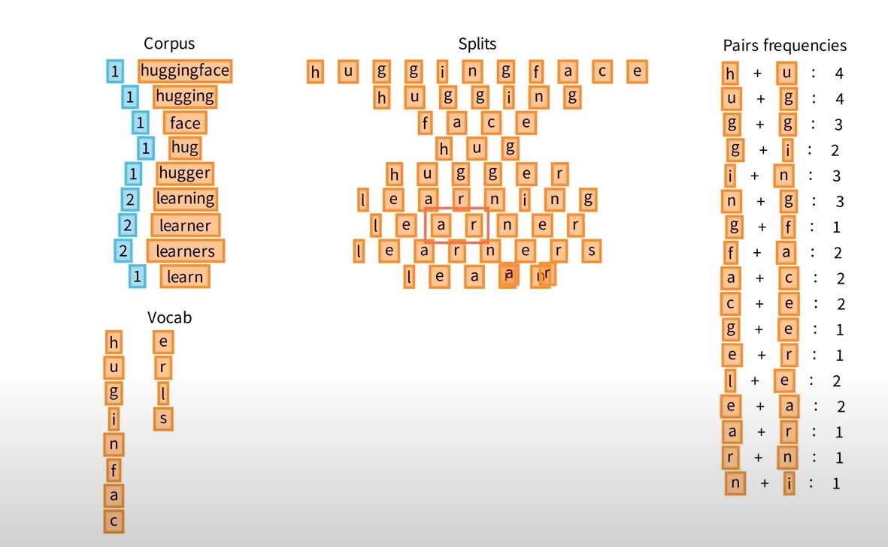
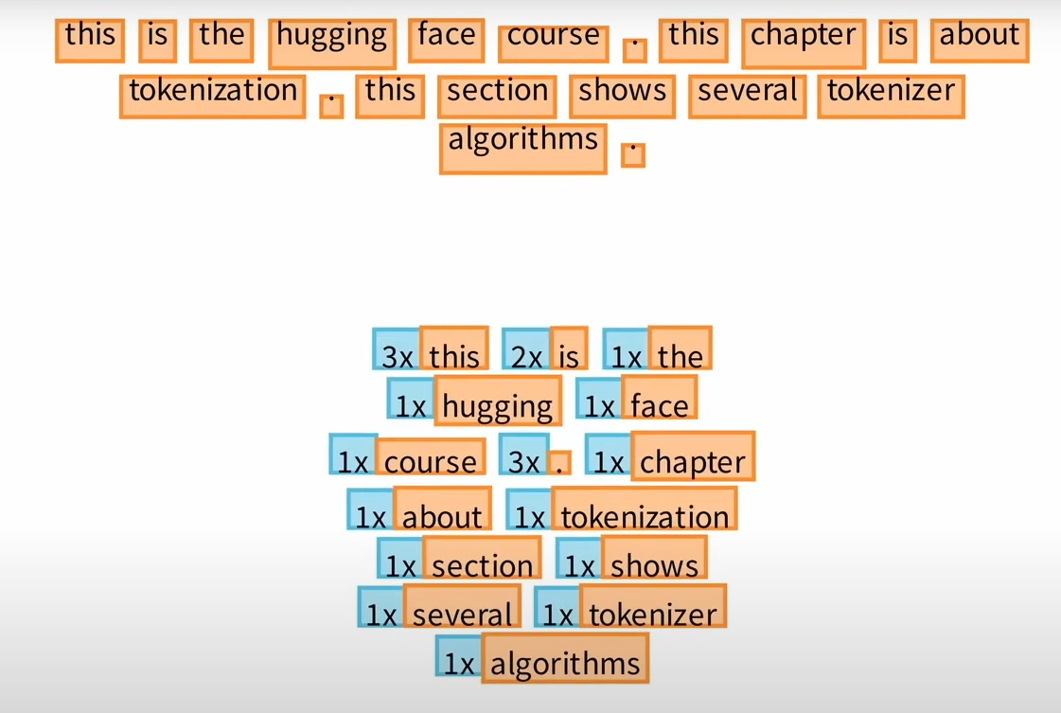
BytePairEncoding

Slide 33
BytePairEncoding

Slide 34
BertConfig >> TFBertEmbedding
from transformers.models.bert.configuration_bert import BertConfig
config = BertConfig() # Load default configutation items
from transformers.models.bert.modeling_tf_bert import TFBertEmbeddings
bert_embedding = TFBertEmbeddings(config)
bert_embedding(tf.constant([[111]]))
Layer call with input_ids (bert_embedding(tf.constant([[111]])) )
__call__ (at base_layer Keras) >> build (at TFBertEmbeddings)

Slide 35




TFBertSelfAttention

Slide 36



Causal Mask >> extended_attention_mask
extended_attention_mask
compute attention scores
This is 4D attention mask:
(B, 1, 1, Tx) in case encoder
(B, 1, Tx, Tx) in case decoder
is built in TFBertMainLayer
Causal_mask
Using for decoder layer.
This is 3D attention mask: (B, Tx, Tx)
is built in TFBertMainLayer
seq_ids = tf.range(mask_seq_length) causal_mask = tf.less_equal( tf.tile(seq_ids[None, None, :], (batch_size, mask_seq_length, 1)), seq_ids[None, :, None], )

Slide 37
TFPreTrainedModel
Use hf_compute_loss function to add customize loss

